Slide 1
How to make Pierogi
In this presentation I will show you how to do Pierogi in 5 easy steps.

Slide 2
Ingredients
5 cups of flour
1 cup of water
3 large eggs
½ cup of butter
4 medium potatoes (peeled and cubed)
2 medium onions (chopped)
2 tablespoons of butter
5 ounces of cream cheese
½ teaspoon of salt
½ teaspoon of pepper

Slide 3
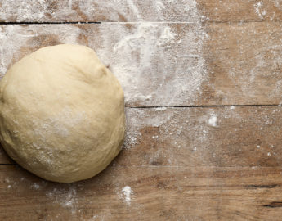
Step 1
Combine flour and salat; cover and pulse to blend. Add some water, eggs and butter; cover and pulse until dough forms a ball. You can add from 1 to 2 additional tablespoons of water if dough is too sticky or flour if dough isn't sticky enough.

Slide 4
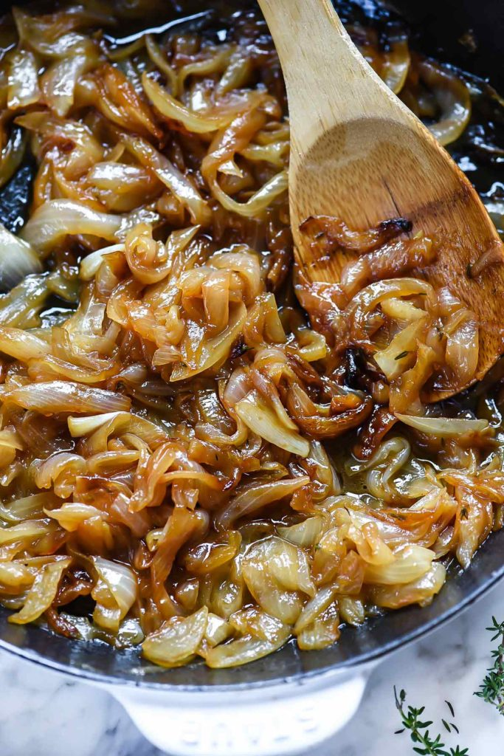
Step 2
Place potatoes in a large saucepan and cover with water. Bring to a boil over high heat. Then reduce heat; cover and simmer until tender, 10-15 minutes. Meanwhile, in a large skillet over medium-high heat, saute onions in butter until tender; set aside.

Slide 5
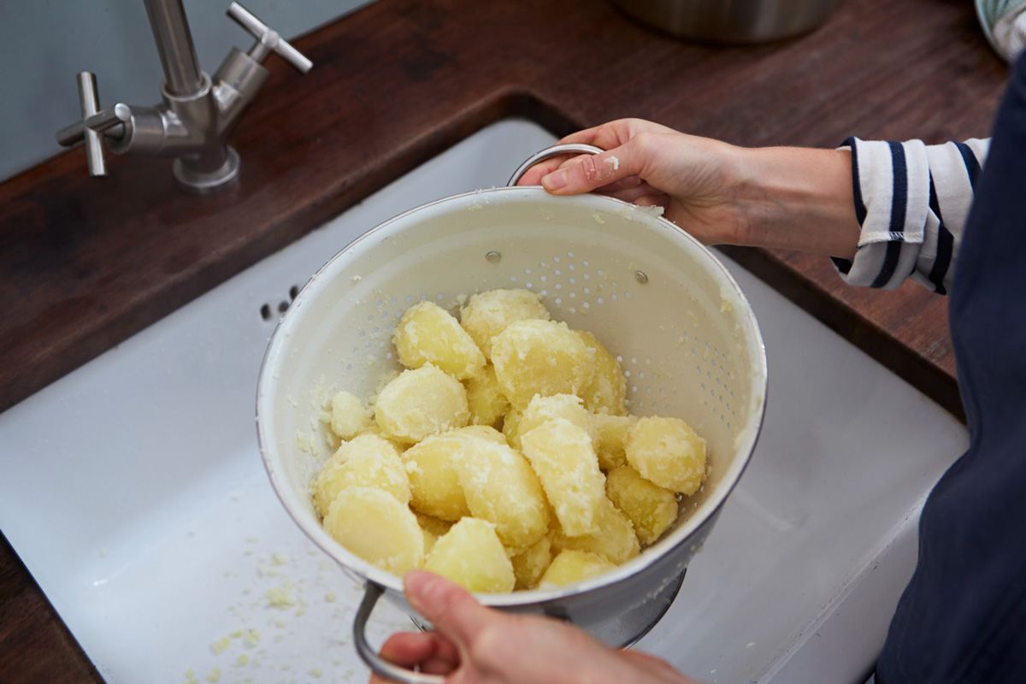
Step 3
Drain potatoes. Over very low heat, stir potatoes until steam has evaporated, 1-2 minutes. Press through a potato ricer or strainer into a large bowl. Then Stir in cream cheese, salt, pepper and onion mixture and set aside.

Slide 6
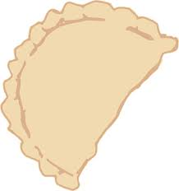
Step 4
Cut dough into 4 parts. On a lightly floured surface, roll 1 portion of dough to 1/8-inches thickness; cut with a floured 3-in. biscuit cutter. Place 2 teaspoons of filling in center of each circle. Moisten edges with water; fold in half and press edges to seal. Repeat with remaining dough and filling.

Slide 7
Step 5
Bring a Dutch oven of water to a boil over high heat; add pierogi in batches. Reduce heat to a gentle simmer; cook until pierogi float to the top and are tender, 1-2 minutes. Remove with a slotted spoon. In a large skillet, saute 4 pierogi and onion in butter until pierogi are lightly browned and heated through; sprinkle with parsley. Repeat with remaining pierogi.

Slide 8
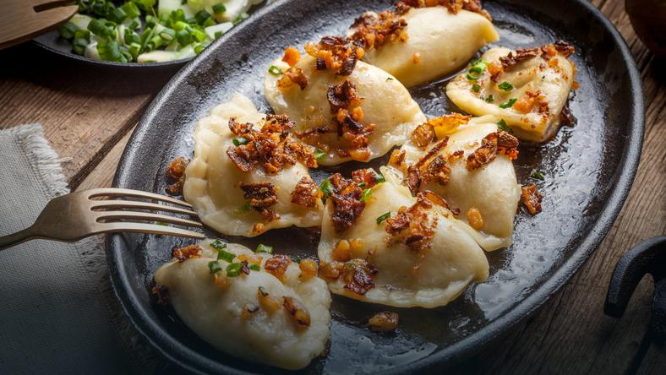
Thank you for your attention! Enjoy your food!

